Slide 1

Lecture 6. Fundamentals of wetting phenomena. Adhesion and cohesion work. Capillary pressure.
The difference in the composition and structure of phases in contact, as well as the nature of the intermolecular interactions in the bulk of these phases, stipulates the presence of a peculiar unsaturated molecular force field at the interface.
As a result, within the interfacial layer the density of such thermodynamic functions as free energy, internal energy and entropy is elevated in comparison with the bulk.
The large interface present in disperse systems determines the very important role of the surface (interfacial) phenomena taking place in such systems.
.
Adilbekova A.O

Slide 2
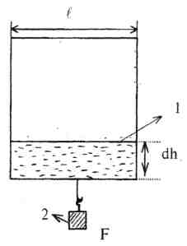
Surface tension
[J/m²]
dW=f dh
dE= σds= σ2ldh
f dh= σ2ldh
[N/m]
A. Dupre experiment

Slide 3
Chemical nature of substances
substance | Surface tension, mJ/m² (298 К)
helium | 0,2
nitrogen | 8,3
hexane | 17,9
Ethyl alcohol | 22,1
tetrachlormethane | 25,0
sulpher carbon | 31,5
Benzene | 28,2
Aniline | 43,2
water | 71,95
Mercury | 473,5

Slide 4
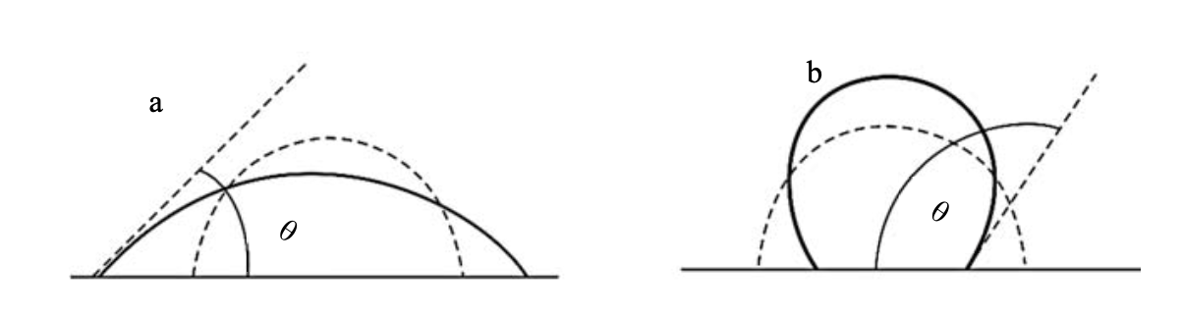
Modification of solid surfaces by wetting phenomena. Flotation as an enrichment method of sulfide ores.
Wetting is a surface phenomenon proceeding at the interface of solid and liquid phases. σ_{s-g} > σ_{s-l} wetting
σ_{s-g} – σ_{s-l} >σ_{l-g} spreading
σ_{l-g} < σ_{l-g} non-wetting

Slide 5
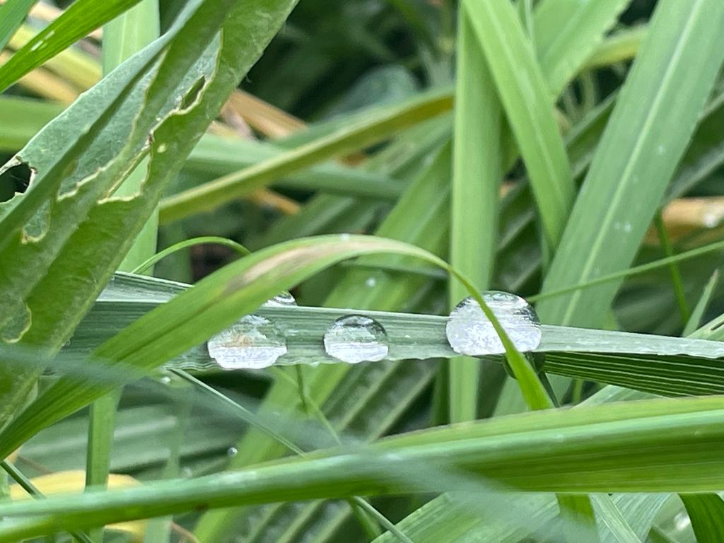

Slide 6
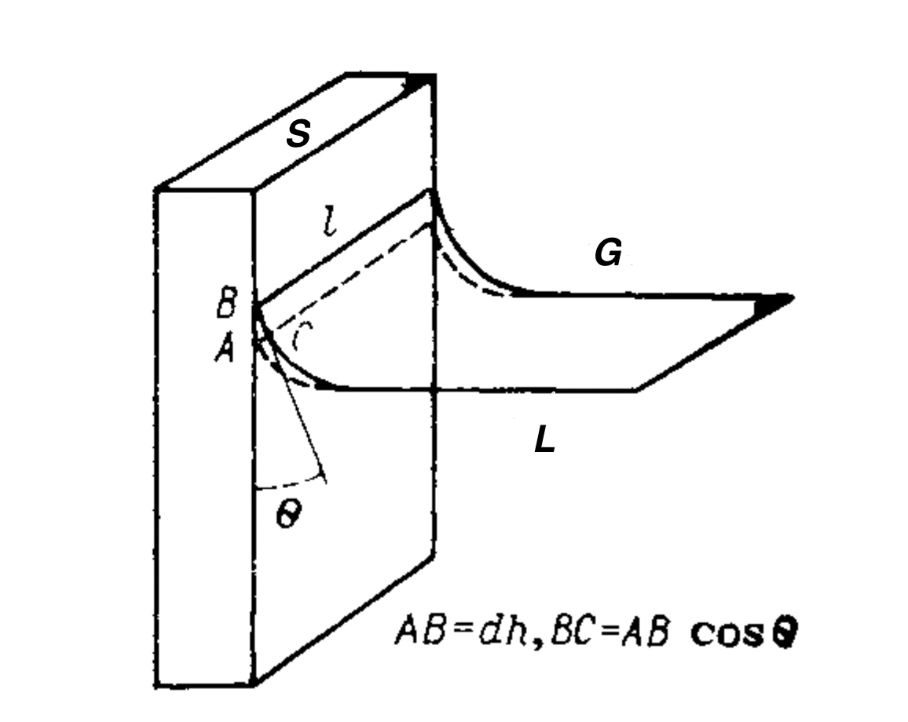
`
$l dhσ_{sl}+l BCσ_{lg}=l dh σ_{sl}+l dh cosθ ∙ σ_{lg}$
F=0
ldhσ_{SG}

Slide 7
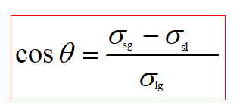
Young equation
Non -wetting
σ_{sl} > σ_{sg}, cosθ < 0, θ > 90º.
Wetting
σ_{sl} < σ_{sg}, cosθ > 0, θ < 90º.

Slide 8
Adhesion work
W_{c} =2σ_{lg}
Cohesion work
W_{а} = σ_{lg} + σ_{sg} – σ_{sl}
Dupre-Young equation
W_{а} = σ_{lg}(1+cosӨ)
Wetting
W_{а} >0,5W_{с}
Non-wetting
W_{а} = 0
Spreading
W_{а} = W_{с}

Slide 9
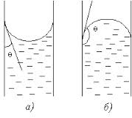
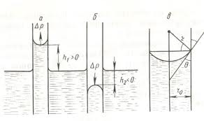
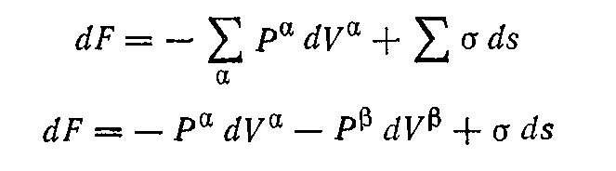
Capillary pressure.
- curvature
relationship
ΔР and

Slide 10


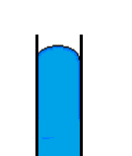
dF=0
dV(α) = - dV(β)
P_{α} - P_{β} = σ ds/dV^{α}
P_{α} > P_{β}
S = 4πr²
dV = 4πr² dr; dS = 8πr dr
Laplace-Young law spherical surface
P_{α} - P_{β} = 2σ/r
ellipsoidal surface
cylinder surface
r₂ = ∞

Slide 11
Т= 293 K
σ = 72,75 mН/m,
r =10⁻⁶ m
r =10⁻⁷ m, Δp =1,5 MPа
r =10⁻⁸ m, Δp =15 MPа

Slide 12
Method of maximal pressure of bubble
(Rehbinder pressure )
3
4
σ₁ = (r/2)P₁; σ₂ = (r/2)P₂ .
1
9
8
6
2
5
7

Slide 13
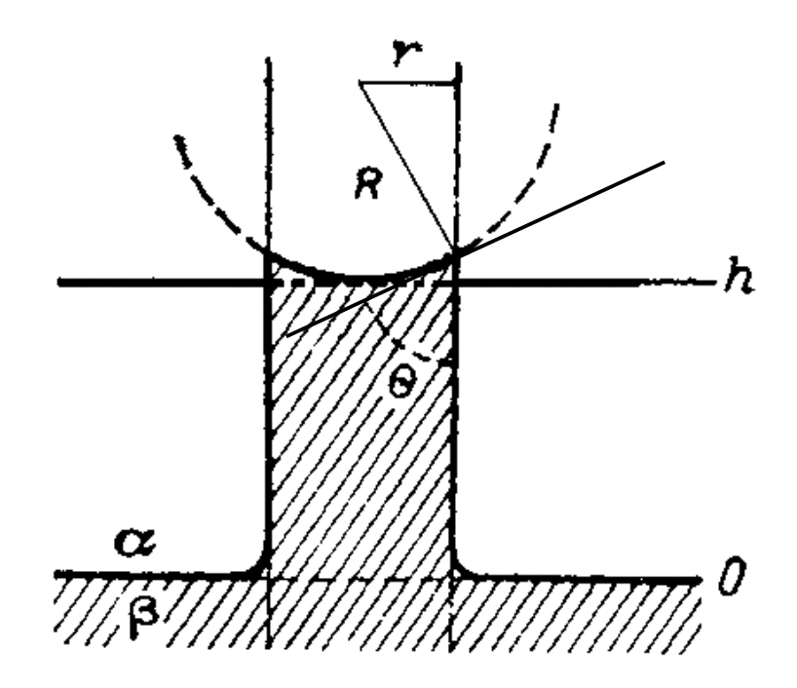
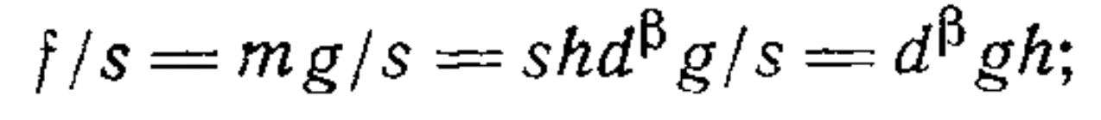
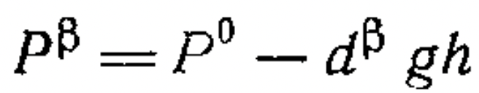
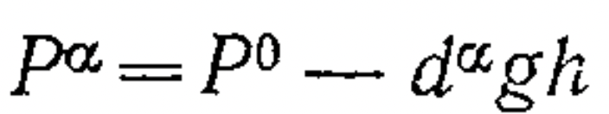
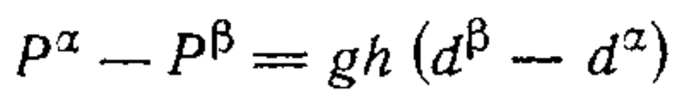
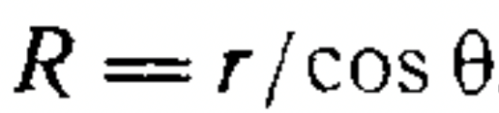
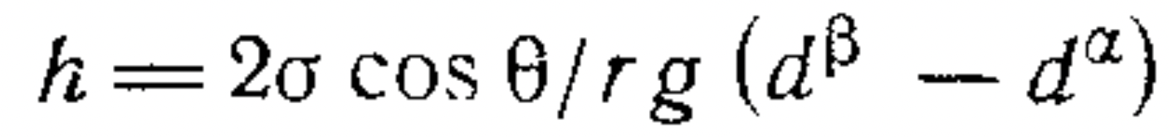
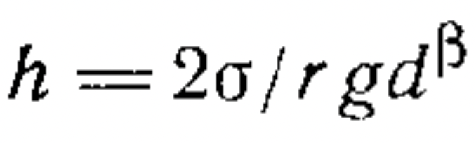
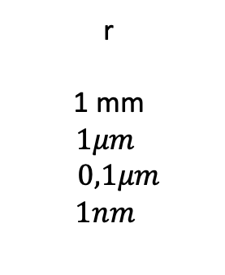
Change of level of liquid in capillar. Application of capillary phenomena.
Jurin law:
r
1 mm
$$1μm$$
$$0,1μm$$
$$1nm$$
h
1,5cm
15m
150m
15km

Slide 14
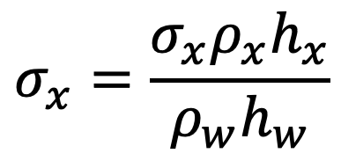

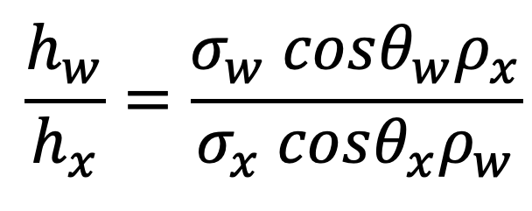
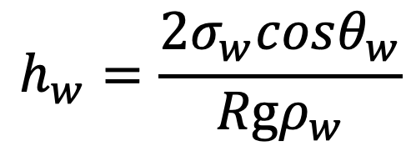
Determination of surface tension by liquid capillary rise
$$h_{w}=\frac{2σ_{w}cosθ_{w}}{Rgρ_{w}}$$
$$\frac{h_{w}}{h_{x}}=\frac{σ_{w} cosθ_{w}ρ_{x}}{σ_{x} cosθ_{x}ρ_{w}}$$
$$\frac{h_{w}}{h_{x}}=\frac{σ_{w} ρ_{x}}{σ_{x} ρ_{w}}$$
if cos θ_{в} ≈ cosθ_{X} ≈ 1, then:
$$σ_{x}=\frac{σ_{x}ρ_{x}h_{x}}{ρ_{w}h_{w}}$$

Slide 15
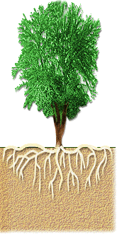
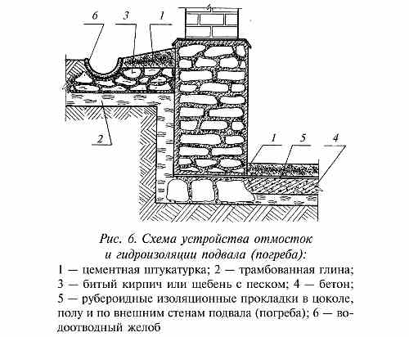
Capillary action- tendency of liquid to rise in narrow tubes:
- Plants to move water (and dissolved nutrients) from their roots to their leaves
- The movement of blood through veins

Slide 16
Questions?
Thank you for your attention!

